Slide 1
Mysql
My Structured Query Language
BY
Jai Vignesh G

Slide 2
contents
Introduction
Data Types
Basic Queries
Where Clause and conditions
Distinct
Order By
Functions
Using date
Constraints
Triggers

Slide 3
Introduction
Database is collection of data
Structured Query Language(SQL) lets you perform CRUD operations Create/Read/Update or Delete operations on a database
Database Management System(DBMS) is a software interface between database and end user that is responsible for authentication, concurrency, logging, backup, optimization etc.
There are many types of database - Relational, Hierarchical, Network, NoSQL etc.
Examples of RDBMS
MySql – OpenSource
SQL Server – Microsoft
Oracle – IBM
PostgreSQL - OpenSource

Slide 4
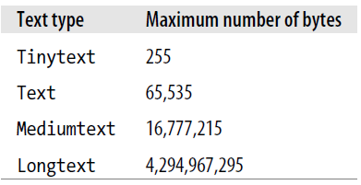
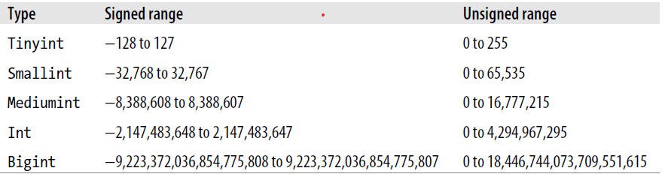
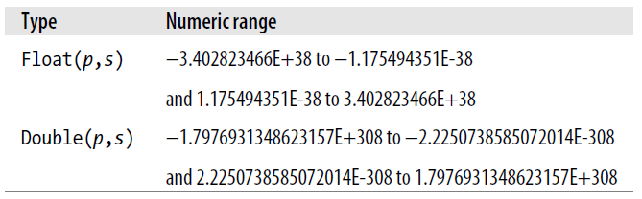
Data types
Character Data
char - eg:char(5) stores fixed length string of length 5. Max 255 bytes.
varchar - eg:varchar(5) stores variable length string of length 5. Max 65535 bytes.
SHOW CHARACTER SET; -- shows various character sets that are supported.
Numerical Data
Whole Numbers:
Decimal Numbers:

Slide 5
Basic queries
Database Queries
CREATE DATABASE LOGICFIRST; -- creates a new database
-- TO DELETE A DATABASE
DROP DATABASE LOGICFIRST;
DROP SCHEMA LOGICFIRST; -- same as above. u can use DATABASE Or SCHEMA
DROP SCHEMA IF EXISTS LOGICFIRST; -- prevents error if db not found
SHOW DATABASES; -- shows all the databases
SHOW SCHEMAS; -- same as above. shows schemas/db
USE SYS; -- uses this database for all further commands
SHOW TABLES;-- shows all tables in the database being used

Slide 6
TABLE(create,delete,alter)
Create table
This table is to create a table top an existing table.
Syntax : CREATE TABLE table_name ( column1 datatype, column2 datatype, column3 datatype);
The SQL query to create table
CREATE TABLE Emp_details
( Emp_id INT,
Emp_name VARCHAR(20),
Designation_id INT,
Dep_no INT,
Date_of_join DATE,
PRIMARY KEY (Emp_id));

Slide 7
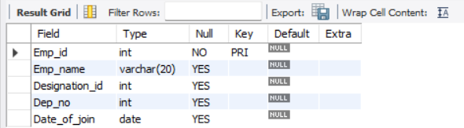
Describe table
This command is used to describe the table’s information like primary key , foreign key , etc…
The SQL query to describe table
DESCRIBE Emp_detials;
INSERT COMMAND
This command is used to insert values to the table which we created
The SQL query to insert value to a table
INSERT INTO emp_detials VALUES
(values);

Slide 8
DROP TABLE COMMAND
This command is used to drop a table created which already existed in database .
Syntax : DROP TABLE table_name;
The SQL query to drop a table
drop table Emp_detials;

Slide 9
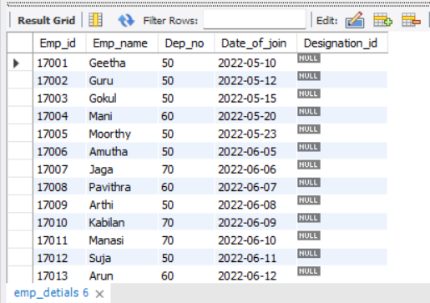
ALTER TABLE – ADDING NEW COLUMN
The ALTER TABLE statement is used to add, delete, or modify columns in an existing table.
The ALTER TABLE statement is also used to add and drop various constraints on an existing table.
ALTERING TABLE COMMANDS
This command is used to add a column to an existing table
The SQL query to add column using alter command
ALTER TABLE emp_detials ADD Designation_id int;

Slide 10
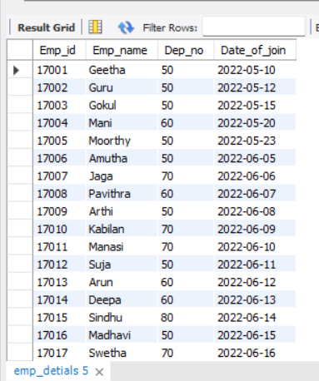
ALTER COLUMN – DROP A EXISTING COMMAND
This command is used to drop(delete) a column in existing table
The SQL query to drop a column
ALTER TABLE emp_detials DROP Designation_id;

Slide 11
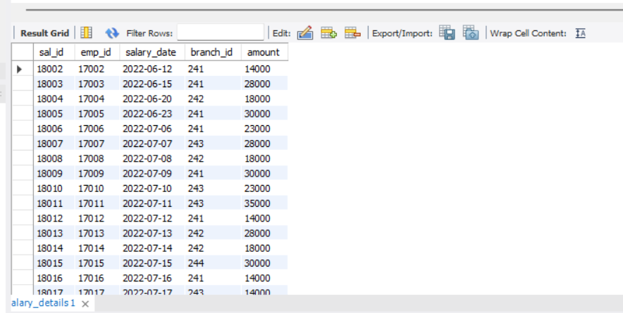
DELETE STATEMENT
This command is used to delete an individual records from table
The SQL query for delete statement
delete from salary_details where emp_id = 17001;

Slide 12
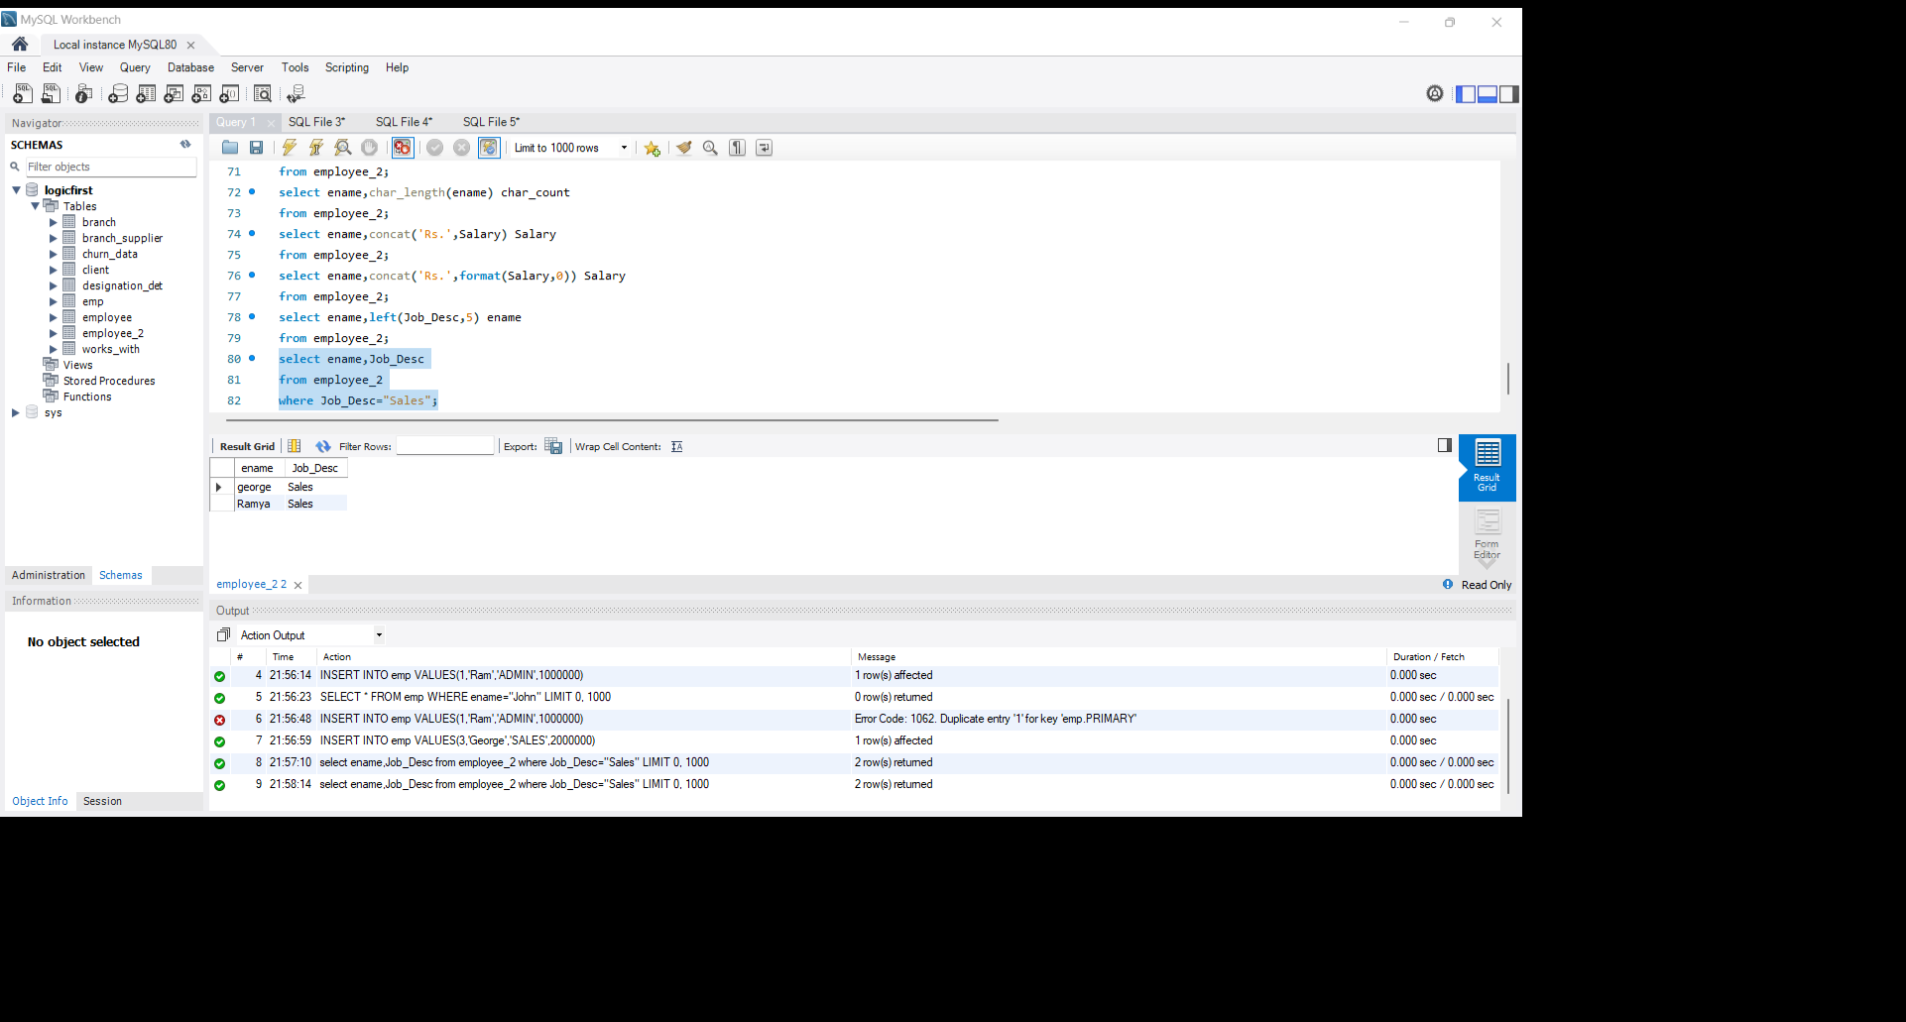
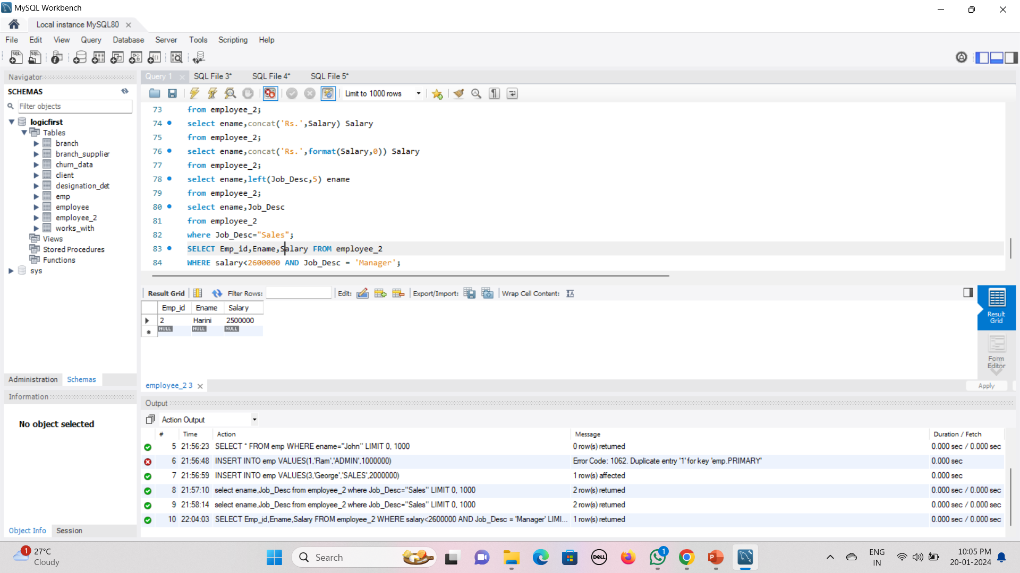
Where clause and conditions
Where is used to filter the records:
AND/OR can be used to combine the relational operators:

Slide 13
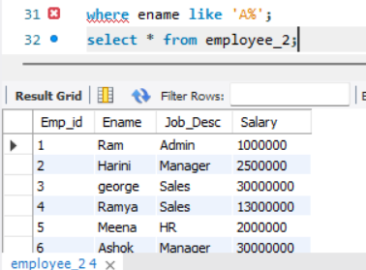
Using Like and wildcards
LIKE is used with WHERE clause for searching a specific pattern in a column. It is used along with the following wild cards
% represents zero or more characters
_ represents exactly one character

Slide 14
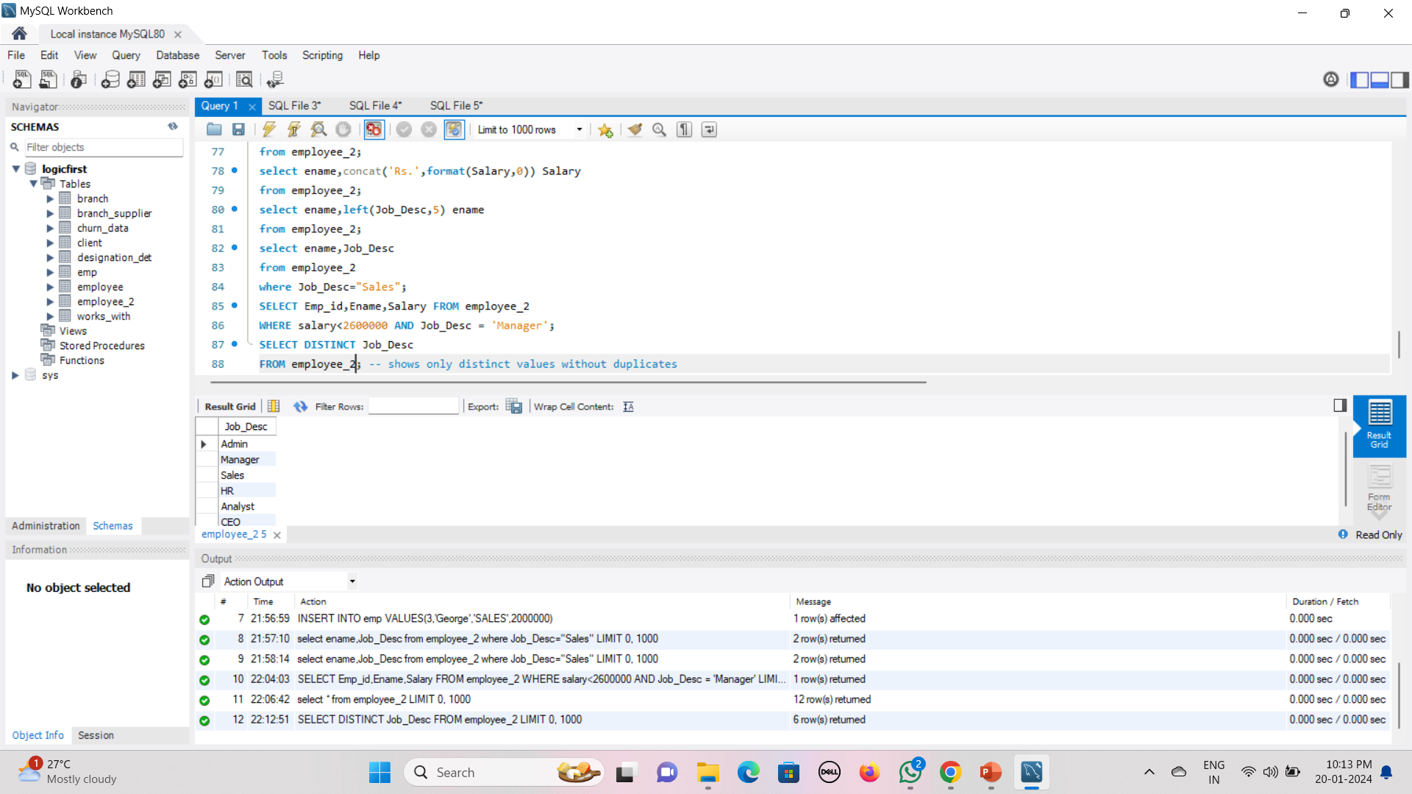
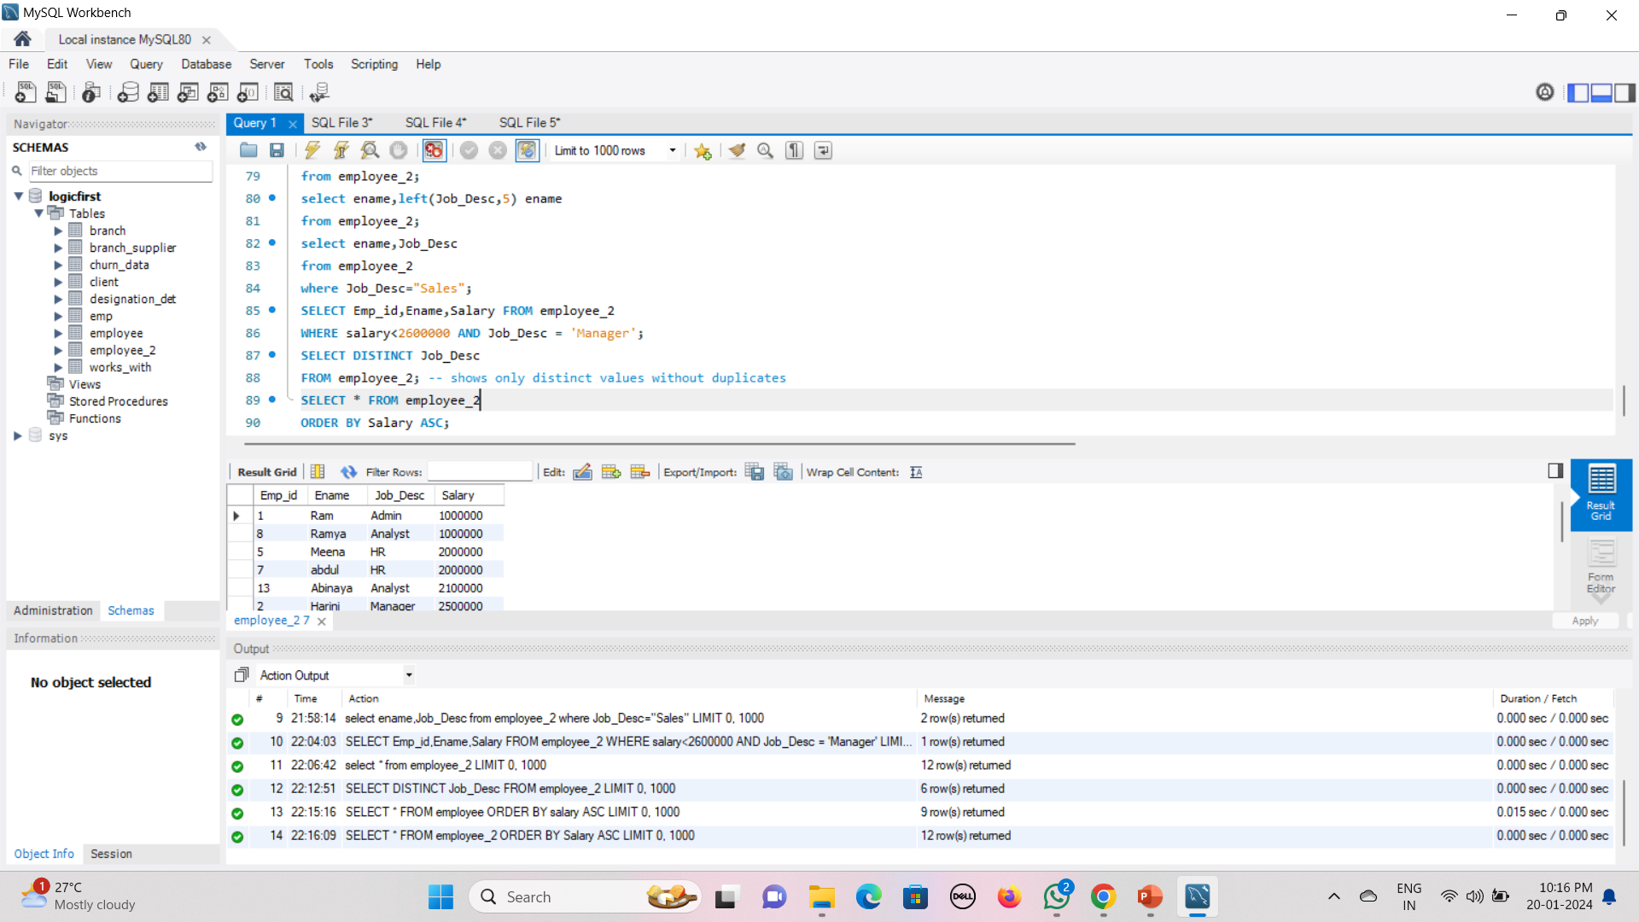
In MySQL, the DISTINCT keyword is used to retrieve unique values from a specified column or set of columns in a SELECT query. On the other hand
ORDER BY clause is used to sort the result set based on one or more columns.
Distinct
Order By

Slide 15
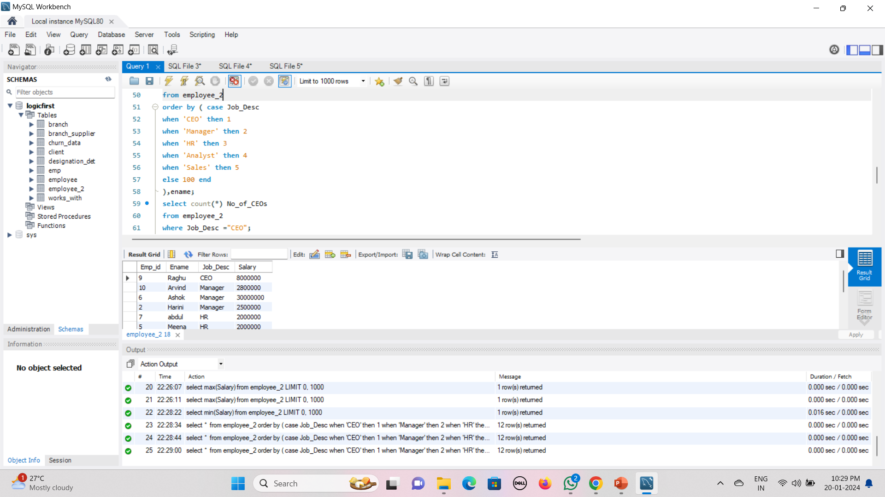
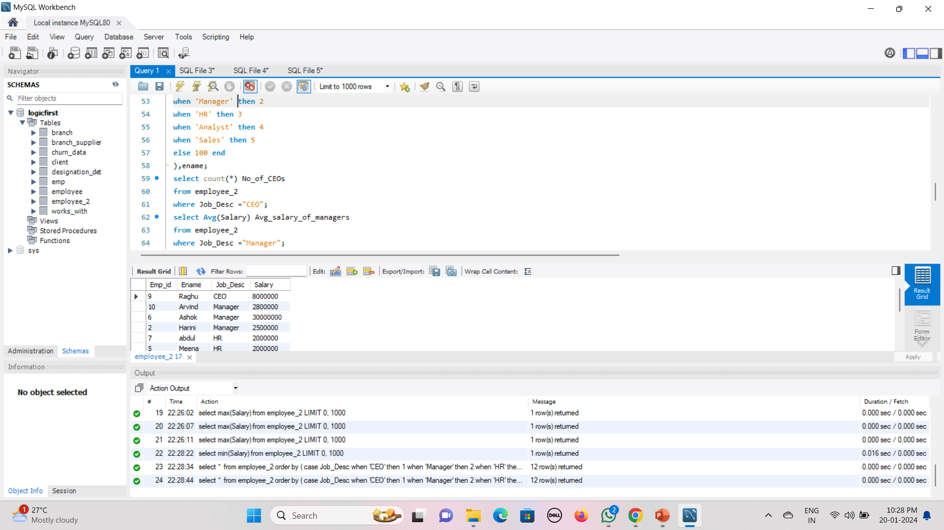
Functions
MySQL supports various built-in functions that allow you to perform a wide range of operations on data
COUNT
COUNT(): Counts the number of rows in a result set.
AVG
AVG(): Calculates the average of values

Slide 16
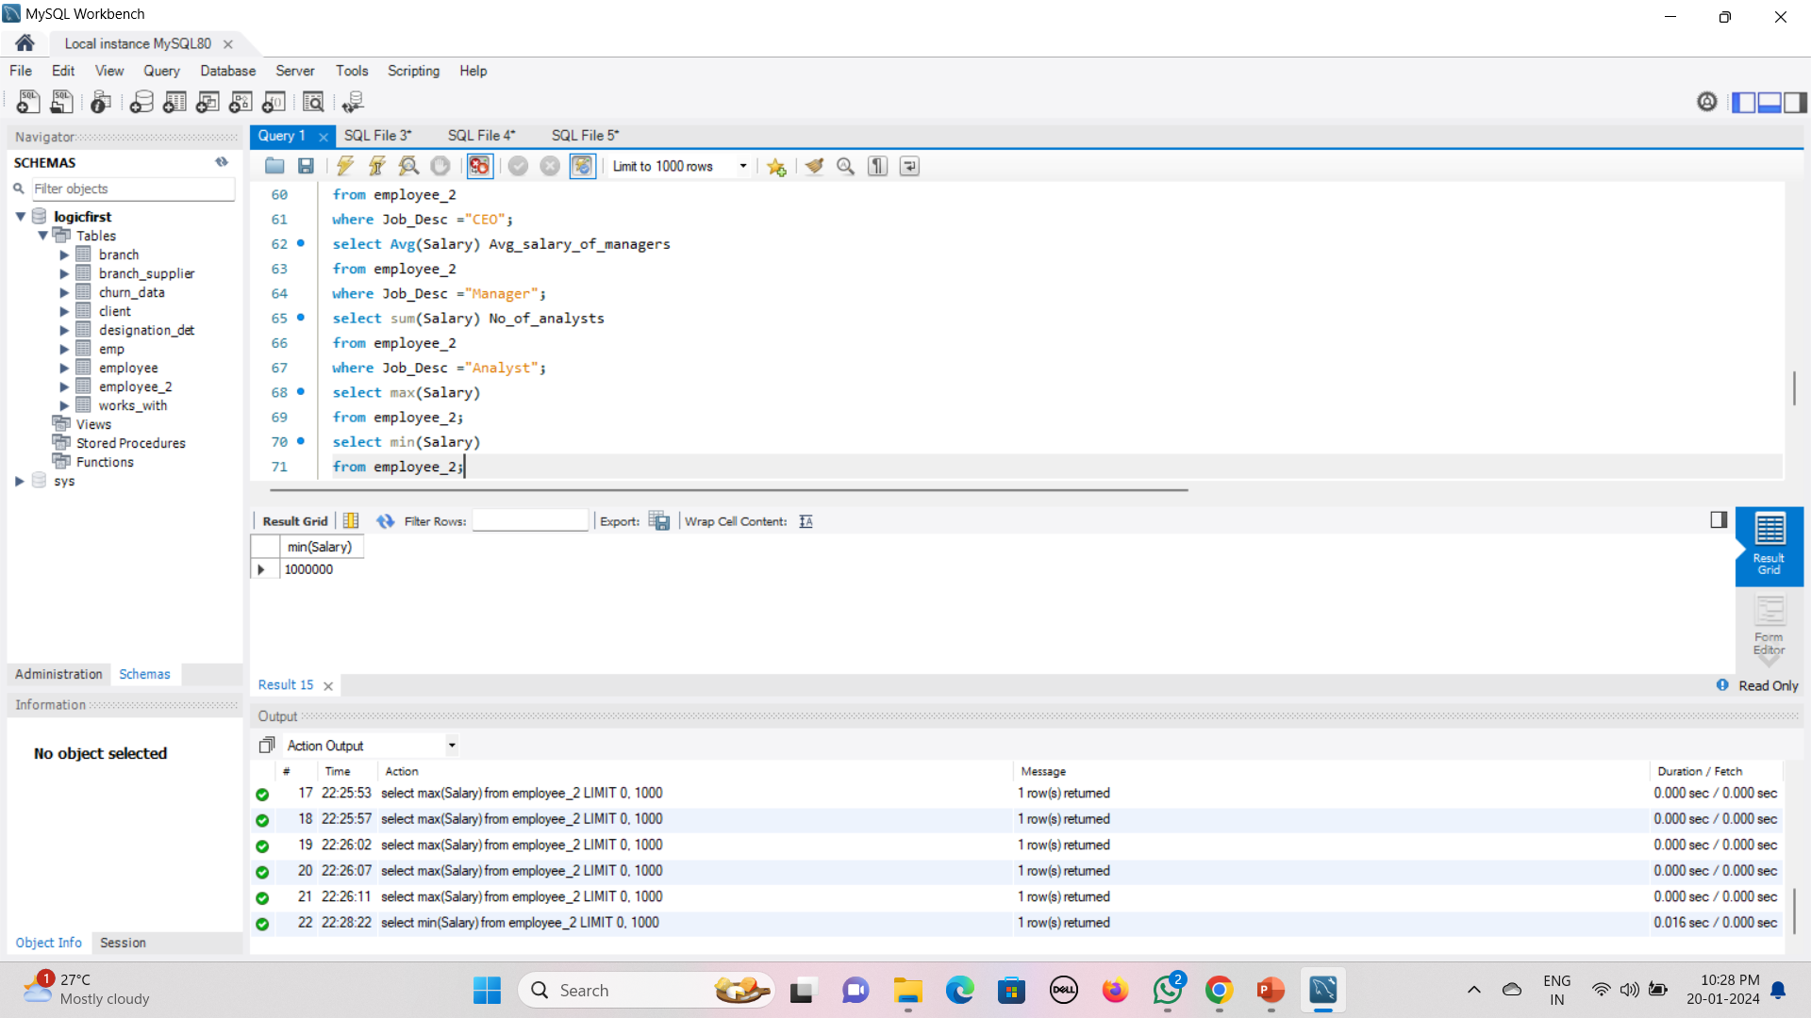
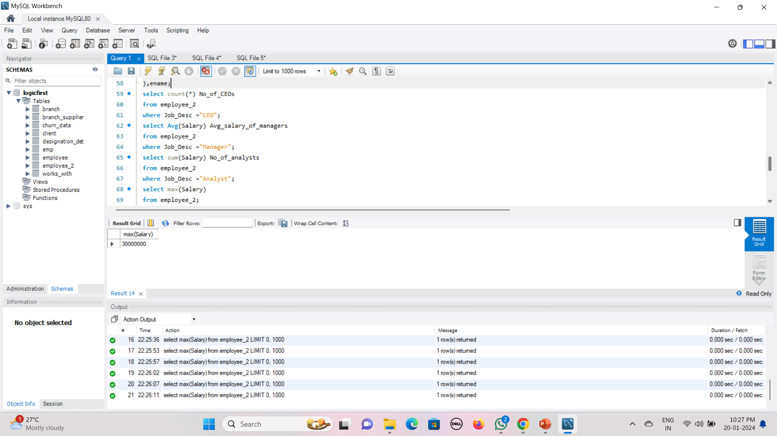
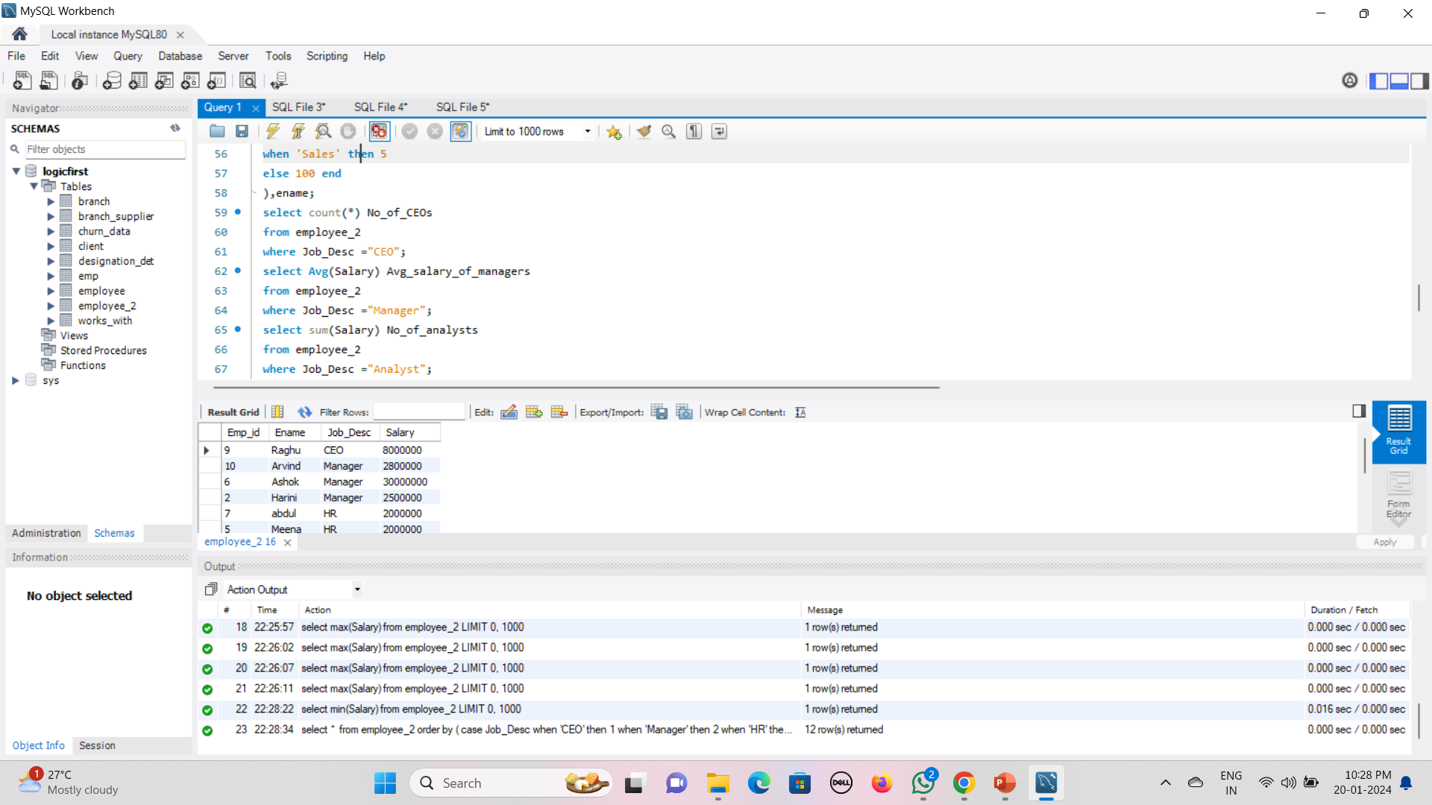
MIN
MAX
MIN(), MAX(): Returns the minimum or maximum value in a set
SUM
SUM(): Calculates the sum of values

Slide 17
My SQL String Functions
LCase
UCase
Left
Right
Concat
Trim
Char_Length
Mid
Length

Slide 18
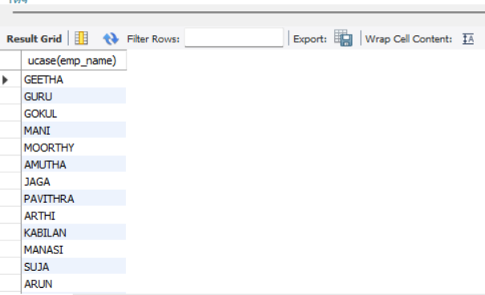
UCASE
This is used to convert the word into upper case
The SQL query to change into upper case
select ucase(emp_name) from emp_details;

Slide 19
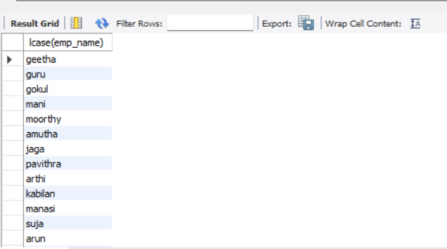
LCASE
This is used to convert the word into lower case
The SQL query to change into upper case
select lcase(emp_name) from emp_details;

Slide 20
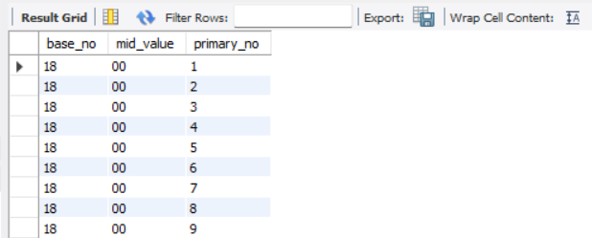
LEFT, RIGHT, MID - SPLIT
This string function is used to split the values
The SQL query for split function
select left (salary_id,2) as base_no,
mid(salary_id,3,2)as mid_value,
right(salary_id,1) as primary_no
from salary_details;

Slide 21
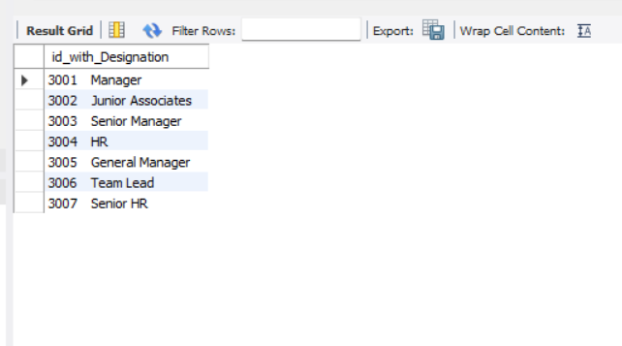
CONCAT
This function is used to concat values of two column
The SQL query to concat
select concat(Designation_id," ", Designation) as id_with_Designation from designation_in_company;

Slide 22
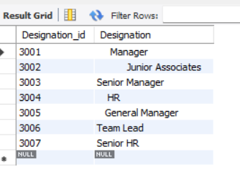
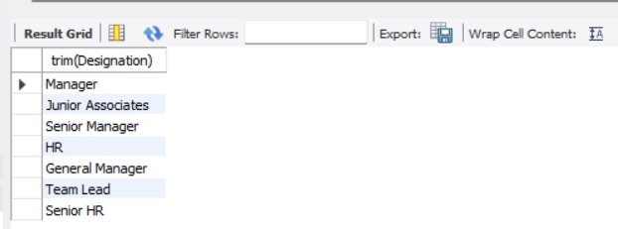
TRIM
This function is used to trim space between front and back of a given data
The SQL command for string function
select trim(Designation) from designation_in_company;
AFTER
BEFORE

Slide 23
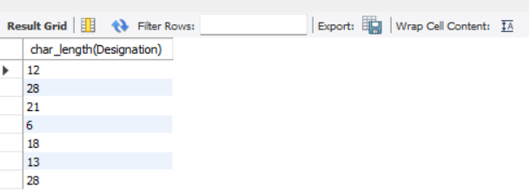
CHAR _LENGTH
This is used to find the length of character
The SQL query for char_length
select char_length(Designation) from designation_in_company;

Slide 24
My SQL Date Functions
Date ADD
Datediff
Timestamp DIff
Date Format
Year
Day
Month
Now

Slide 25
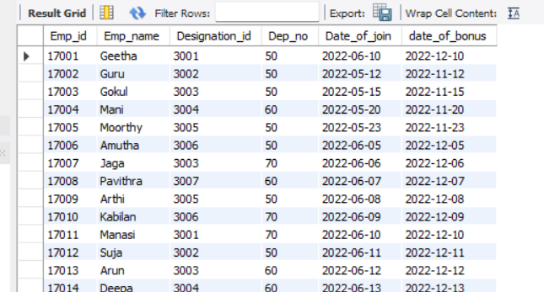
Date ADD
This function is used to calculate date after certain interval
The SQL query for add date
select *, adddate(date_of_join, interval 6 month) as date_of_bonus from emp_details;

Slide 26
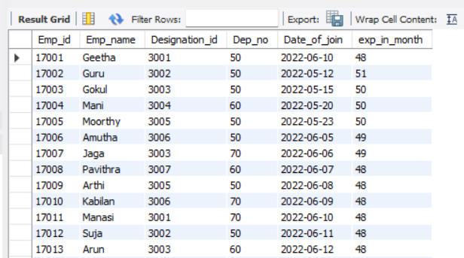
Datediff
This function is used to find date difference from selected date or current date
The SQL query for datediff function
select *, round(datediff(curdate(),date_of_join)/12 ,0) as exp_in_month from emp_details;

Slide 27
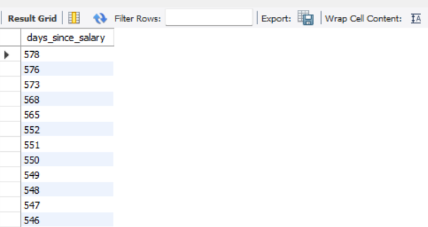
Timestamp DIff
the TIMESTAMPDIFF function in SQL calculates the difference between two timestamps in terms of a specific time unit, like days, months, hours, etc
The SQL query for timestampdiff
SELECT TIMESTAMPDIFF(DAY, salary_date, CURDATE()) AS days_since_salary FROM salary_details;

Slide 28
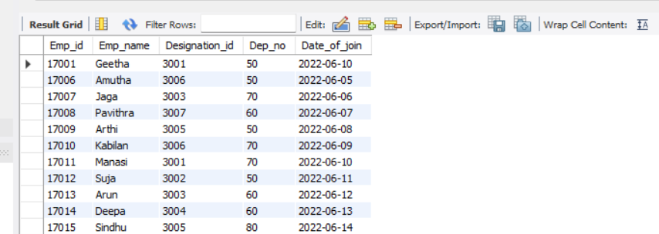
MONTH
To extract the year, from a date or timestamp, you can use this function
The SQL query using year
select * from emp_details where MONTH(date_of_join) = 6;

Slide 29
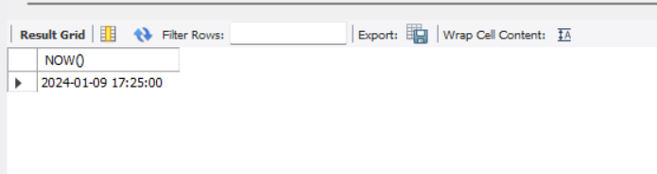
NOW
The NOW() function returns the current date and time.
The SQL query for now() function
SELECT NOW();

Slide 30
MYSQL Constraints
Constraints can be specified when the table is created with the CREATE TABLE statement, or after the table is created with the ALTER TABLE statement.
Syntax : CREATE TABLE table_name (
column1 datatype constraint,
column2 datatype constraint,
column3 datatype constraint,
....
);
SQL constraints are used to specify rules for the data in a table.
PRIMARY KEY
FOREIGN KEY
DEFAUL
NOT NULL

Slide 31
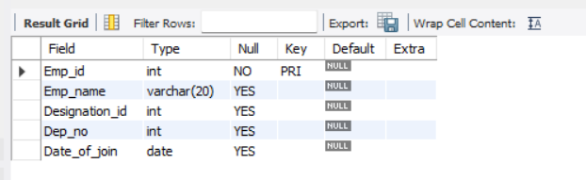
PRIMARY KEY
The PRIMARY KEY constraint uniquely identifies each record in a table.
Primary keys must contain UNIQUE values, and cannot contain NULL values.
CREATE TABLE Emp_details ( Emp_id INT,
Emp_name VARCHAR(20),
Designation_id INT,
Dep_no INT,
Date_of_join DATE,
PRIMARY KEY (Emp_id));

Slide 32
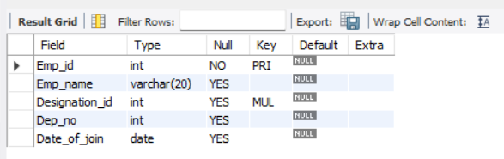
2. FOREIGN KEY
A FOREIGN KEY is a field (or collection of fields) in one table, that refers to the PRIMARY KEY in another table.It show the relationship between the tables.
CREATE TABLE Designations ( Designation_id INT PRIMARY KEY,
Designation_name VARCHAR(50));
CREATE TABLE Emp_details ( Emp_id INT,
Emp_name VARCHAR(20),
Designation_id INT,
Dep_no INT,
Date_of_join DATE,
PRIMARY KEY (Emp_id),
FOREIGN KEY (Designation_id) REFERENCES Designations(Designation_id));

Slide 33
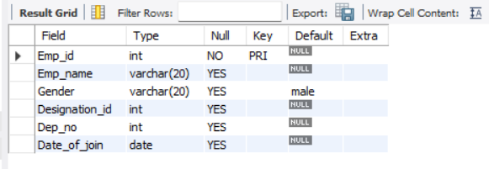
3. DEFAULT
The DEFAULT constraint is used to set a default value for a column.
The default value will be added to all new records, if no other value is specified.
CREATE TABLE Emp_details ( Emp_id INT,
Emp_name VARCHAR(20),
Gender varchar(20) default 'male’,
Designation_id INT,
Dep_no INT,
Date_of_join DATE,
PRIMARY KEY (Emp_id)
);

Slide 34
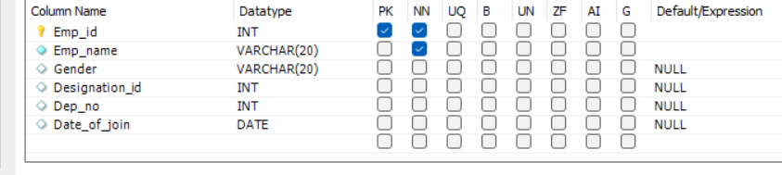
4. NOT NULL
The DEFAULT constraint is used to set a default value for a column.
The default value will be added to all new records, if no other value is specified.
CREATE TABLE Emp_details ( Emp_id INT,
Emp_name VARCHAR(20) not null,
Gender varchar(20) ,
Designation_id INT,
Dep_no INT,
Date_of_join DATE,
PRIMARY KEY (Emp_id));

Slide 35
My SQL General Functions
Where
or
and
in
Not in
>
<
>=
<=
<> (Not in)
!
Distinct
Count With Distinct
Order by Asc
Order By Desc
Group By
Limit
Desc Limit
Like (_%)
Not like
Between

Slide 36
triggers
In MySQL, triggers are special stored programs that are automatically executed in response to specific events on a particular table or view. Triggers are useful for enforcing business rules, validating data changes, or automatically updating other tables when certain actions occur.

Slide 37
JOIN TRIGGERS
This triggers are used to convert a outcome into a new table in database
The SQL query for join trrigers
create TABLE position
select emp_id, emp_name, dep_no,
CASE WHEN dep_no = 50 then
CASE WHEN date_of_join BETWEEN '2022-05-01' AND '2022-05-10' THEN "production dept senior" ELSE "production dept junior"
end
when dep_no = 60 then
case
WHEN date_of_join BETWEEN '2022-05-01' AND '2022-05-10' THEN " HR dept senior"
ELSE "HR dept junior"
end
else "other department"
END AS positions
FROM emp_details;

Slide 38
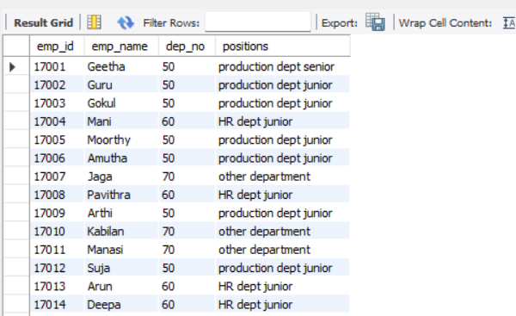

Slide 39
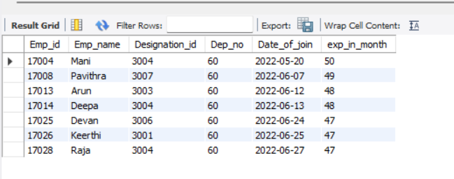
HAVING clause
This clause is used to extract a information from outcome with out converting them into tables
The SQL query for HAVING clause
select *, round(datediff(curdate(),date_of_join)/12 ,0) as exp_in_month
from emp_details
where dep_no = 60 having exp_in_month >45;

Slide 40
Procedures concepts (SQL Automation)
Procedure creation
Begins & end
call Procedures
Alter procedures
Declering variables
Store variables

Slide 41
PROCEDURE CREATION with BEGINS and END
delimiter //
create procedure store_data()
Begin
select * from emp_details;
select * from emp_details where date_of_join between '2022-5-01' and '2022-5-31’ ;
select *, round(datediff(curdate(),date_of_join)/12 ,0) as exp_in_month from emp_details where dep_no = 60 having exp_in_month >45;
end //
delimiter ;
call store_data();

Slide 42
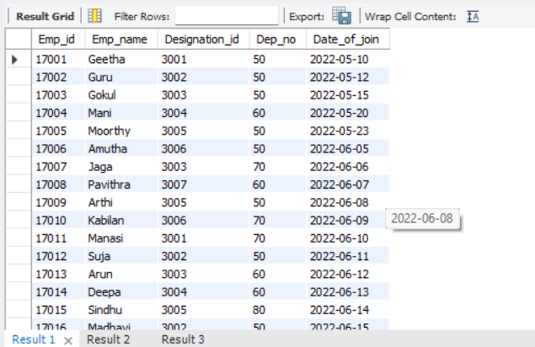

Slide 43
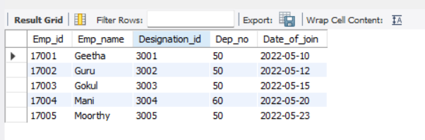
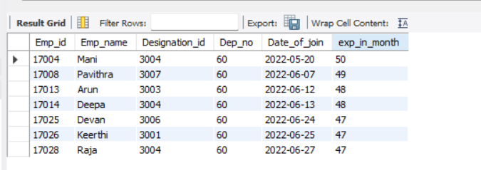

Slide 44
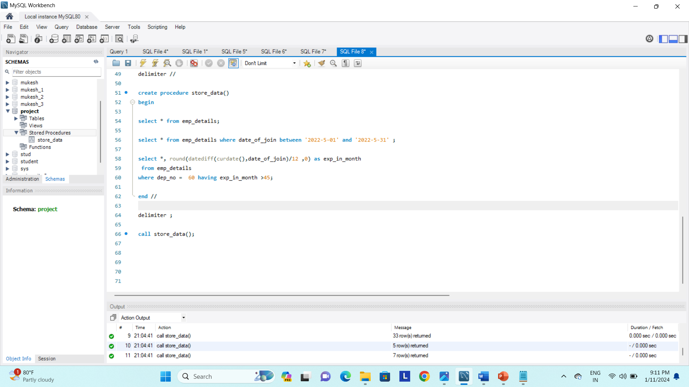
ALTERATION PROCEDURE
Step 1 : under schemas section select store data

Slide 45
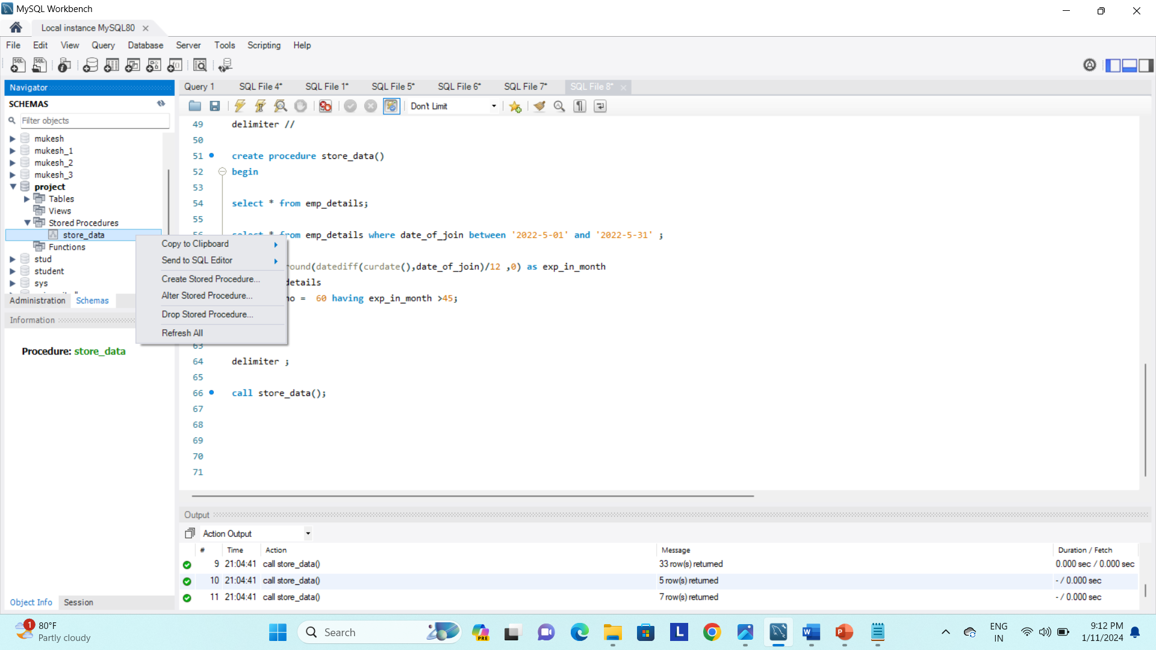
Step 2 : right click store data a pop up appaers

Slide 46
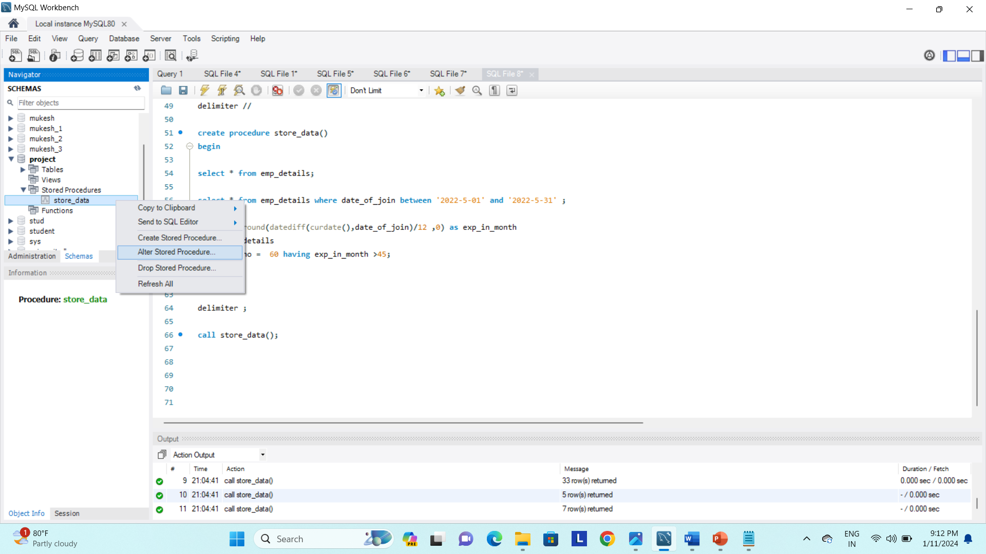
Step 3 : from that select alter store procedure

Slide 47
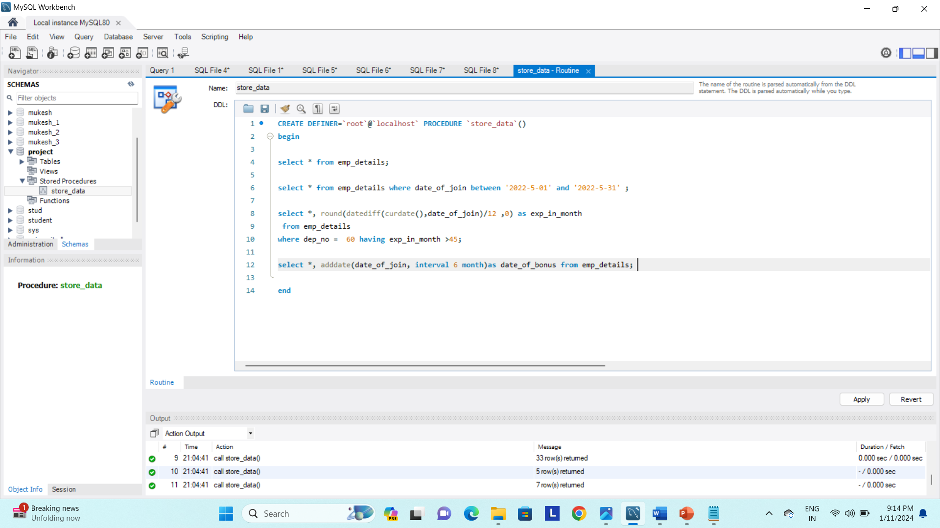
Step 4 : enter the required query

Slide 48

Step 5 : click apply

Slide 49
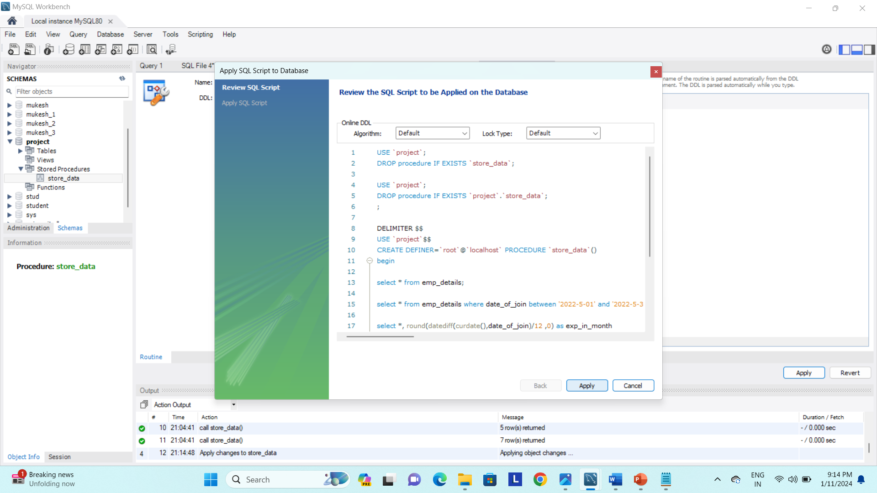
Step 6 : click apply

Slide 50
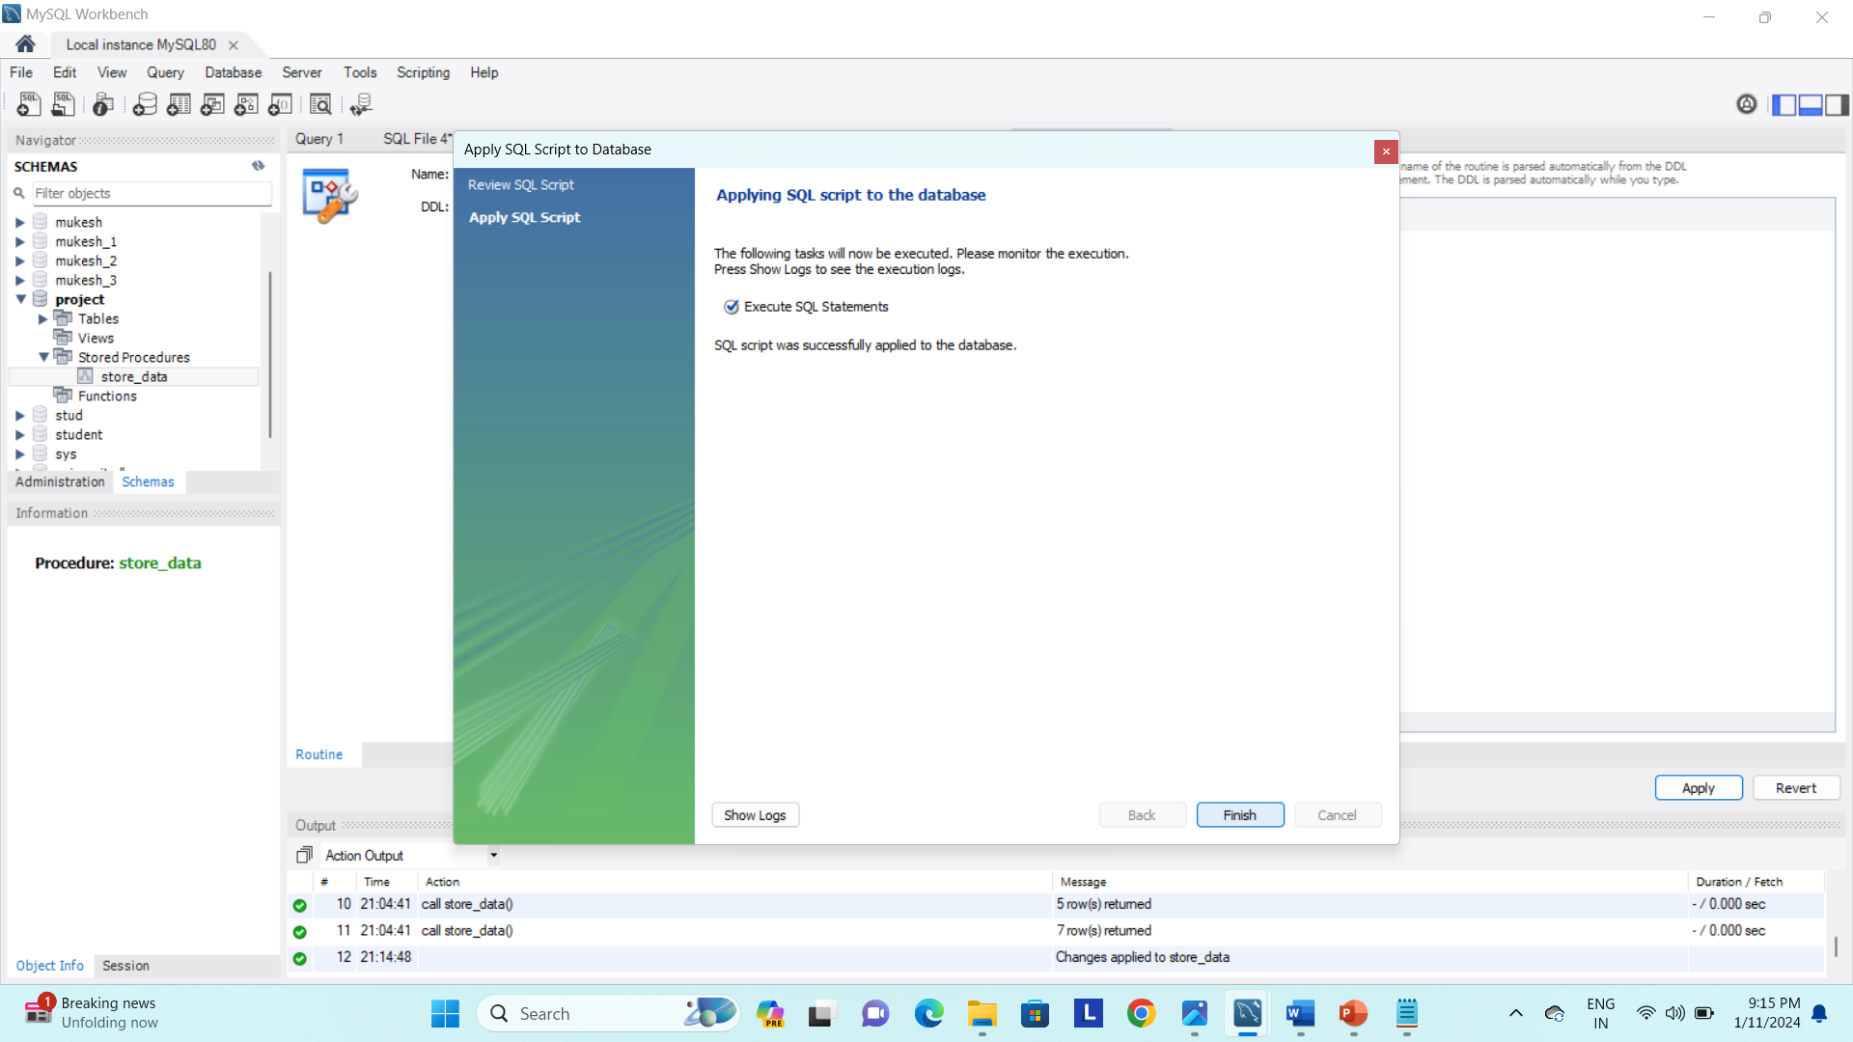
Step 7 : click finish

Slide 53
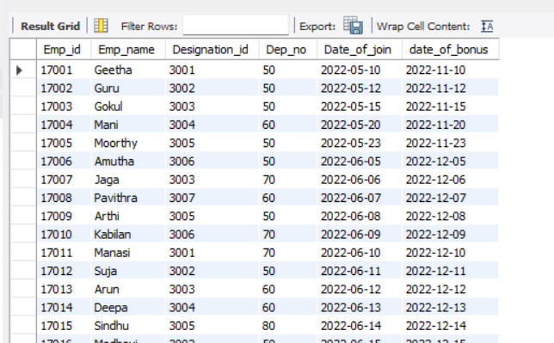

Slide 54
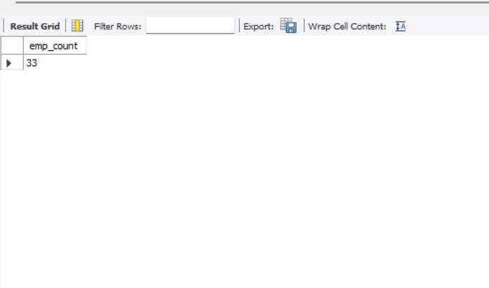
DECALRING AND STORING VARIABLES
delimiter //
create procedure variable()
Begin
declare emp_count int;
select count(emp_name) into emp_count
from emp_details;
select emp_count;
end//
delimiter ;
call variable();

Slide 55
Types of Trigger
Row level Trigger
A event is triggered at row level for each row updated, inserted or deleted.
Statement Level trigger
An event is triggered at table Level for each sql statement executed
triggers Timings
before insert
after insert
before update
after update
before delete

Slide 56
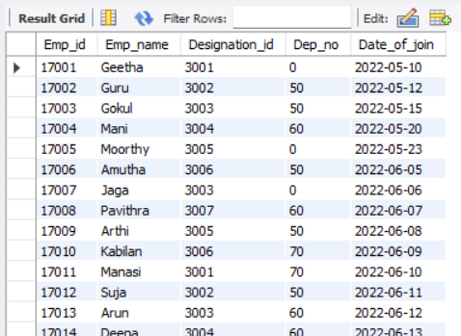
A trigger
- is a user-defined SQL command that invokes automatically in response to a event such as insert, delete or update
BEFORE INSERT
DELIMITER //
CREATE TRIGGER dep_no_verification
BEFORE INSERT ON emp_details
FOR EACH ROW
BEGIN
IF NEW.Dep_no IS NULL THEN SET NEW.Dep_no = 0;
END IF;
END //
DELIMITER ;

Slide 57
AFTER INSERT COMMAND
CREATE TABLE Emp_details
( Emp_id INT,
Emp_name VARCHAR(20),
Designation_id INT,
Dep_no INT,
Date_of_join DATE,
PRIMARY KEY (Emp_id) );
CREATE TABLE message
(id int auto_increment primary key,
message_id int,
message varchar(300) not null);

Slide 58
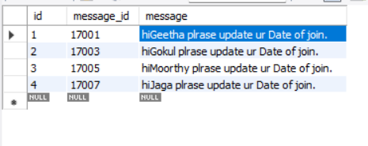
after insert command
delimiter //
create trigger check_null_DOJ
after insert on emp_details
for each row
begin
if new.date_of_join is null then
insert into message (message_id, message)values
(new.emp_id, concat('hi', new.emp_name, ' plrase update ur Date of join.’));
end if;
end //
delimiter ;

Slide 59
BEFORE UPDATE
delimiter //
create trigger update_salary
before update
on salary_details
for each row
Begin
if new.amount >=10000 then
set new.amount = 80000;
elseif new.amount < 10000 thenset
new.amount = ‘low salary;
end if;
end //
delimiter ;
update salary_details set amount = 8000 where emp_id in (17004,17005,17006);

Slide 60
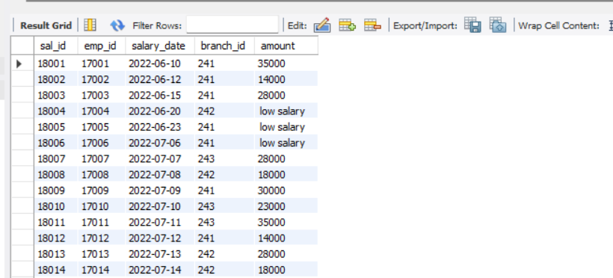

Slide 61
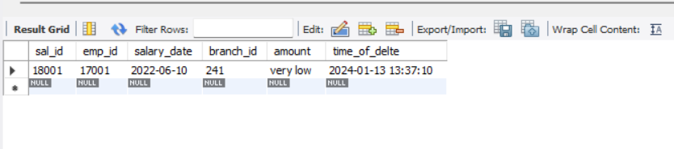
After update
DELIMITER //
CREATE TRIGGER salary_updateAFTER UPDATE
ON salary_details FOR EACH ROW
BEGIN IF new.amount <= 10000 THEN
insert into salary_update (sal_id ,emp_id ,salary_date, branch_id, amount)values (new.sal_id,new.emp_id,new.salary_date, new.branch_id, "very low");
END IF;
END //
DELIMITER ;
update salary_details set amount = 10000 where emp_id = 17001;

Slide 62
BEFORE DELETE
DELIMITER //
CREATE TRIGGER salary_deleted_details
BEFORE DELETE
ON salary_details
FOR EACH ROW
BEGIN
INSERT INTO salary_delete (emp_id, validfrom, amount)
VALUES (OLD.emp_id, OLD.salary_date, OLD.amount);
END //
DELIMITER ;

Slide 63


Slide 64
THANK YOU

